Slide 1
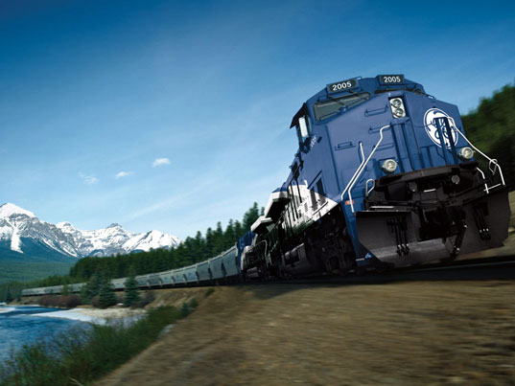
Railroad Block Signal
Railroad Block Signal Software Tool
Team Members:
Kenneth Truex
Chad Mason
Zachary McHenry
Christopher Diebold

Slide 2
Previous Goals
Task | Completion % | Kenneth Truex | Christopher Diebold | Chad Mason | Zachary McHenry | To Do

Slide 3
Milestone 2 Accomplishment Summary

Slide 4
Obtain Requirement Document From GE

Slide 5
Requirements

Slide 6
Requirements

Slide 7
Test Plan

Slide 8
Decide on IDE/Programming Language/Database Tools

Slide 9
Evaluate Selected Tools with Small Examples to Analyze Integration/Cohesiveness of Tools:

Slide 10
Begin Drafting Design of Program and GUI

Slide 11
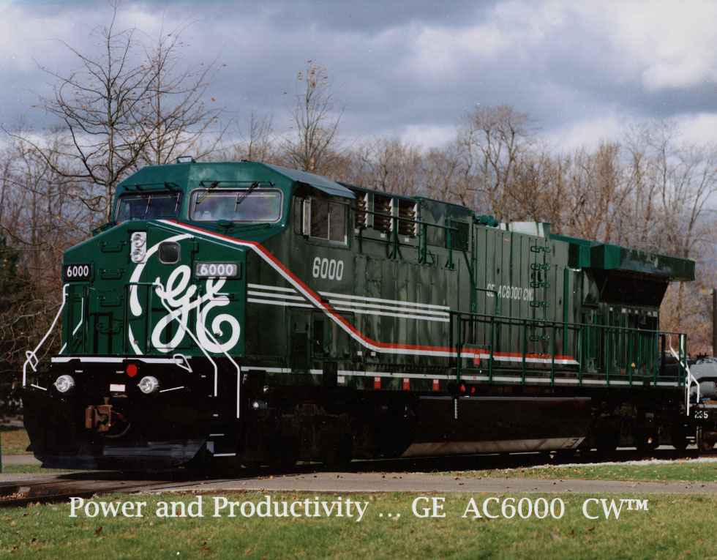
Next Milestone

Slide 12
Milestone 3

Slide 13
Milestone 2 Role Distribution
Task | Chad | Ken | Chris | Zach

Slide 14
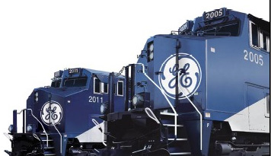
Any Questions?

